Slide 1


VIT-AP
UNIVERSITY
ANTI SLEEP ALARM FOR DRIVERS

Slide 2


CONTENTS
INTRODUCTION
OBJECTIVE
WORKING PRINCIPLE
COMPONENTS USED
INTEGRATING COMPONENTS
WORKING FLOW
FUTURE SCOPE & APPLICATIONS
CONCLUSION

Slide 3
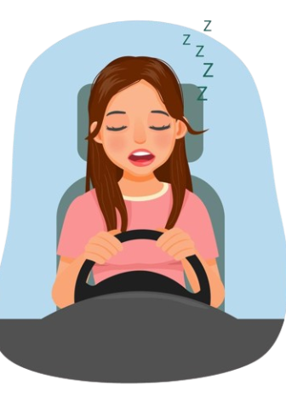
INTRODUCTION
Driving while fatigued poses a significant risk on the road, often leading to accidents with grave consequences. Recognizing this urgent need for safer driving conditions, we embarked on the development of an innovative project – the Antisleep Alarm for Drivers. Our aim was to create a system capable of detecting driver drowsiness and alerting them before potential mishaps occur.

Slide 4


OBJECTIVE
The primary objective of our project was to mitigate the risks associated with driver fatigue by implementing a proactive solution. We sought to develop a mechanism that could effectively detect signs of drowsiness in drivers and provide timely alerts to prevent accidents. Through the integration of advanced technologies and robust hardware components, we aimed to create a reliable system capable of enhancing road safety.

Slide 5




WORKING PRINCIPLE
The working principle of our Antisleep Alarm for Drivers project revolves around the seamless coordination of various components to detect and address driver drowsiness effectively. It begins with the IR Goggles detecting the blinking frequency of the driver, providing crucial input to the Arduino board. Once received, the Arduino initiates a timer and controls the LCD screen, which displays a welcome message and begins counting seconds. As the driver's drowsiness intensifies, indicated by prolonged intervals between blinks, the Arduino gradually increases the volume of the buzzer to alert the driver.

Slide 6

In the event of persistent drowsiness, surpassing a predefined threshold, the system automatically triggers the cessation of the vehicle's movement. This cohesive operation ensures that the driver is promptly notified of their drowsy state and prevents potential accidents by halting the vehicle's motion. Through this working principle, our project aims to safeguard lives on the road by proactively addressing the dangers posed by driver fatigue.

Slide 7
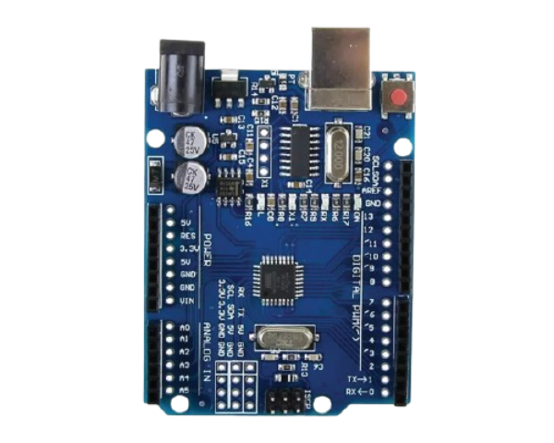
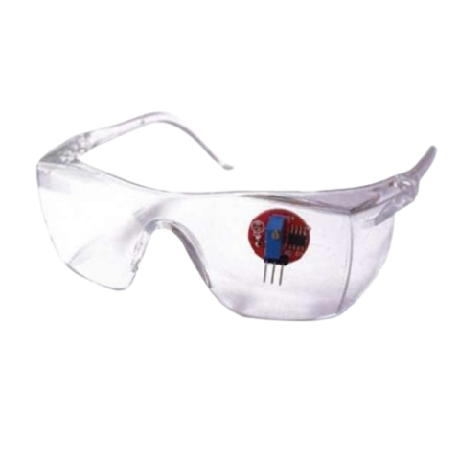
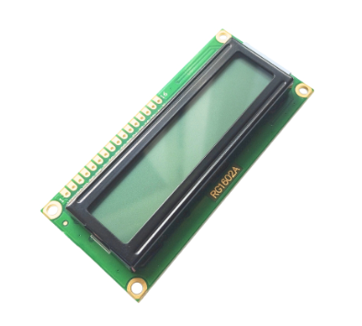
COMPONENTS USED
ARDUINO UNO
IR GOGGLES
LCD SCREEN

Slide 8
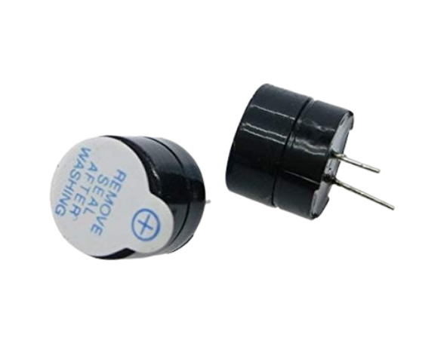
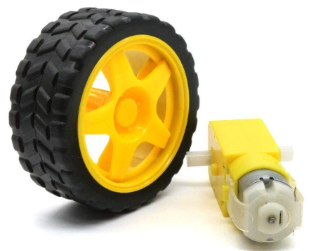
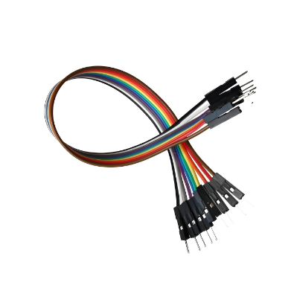
MINI BUZZER
MOTOR AND WHEEL
JUMPER WIRES

Slide 9

INTEGRATING COMPONENTS
The successful implementation of our project relied on seamless integration of various components. We meticulously connected the IR Goggles to the Arduino board, enabling the detection of blinking frequency as a measure of drowsiness. The Arduino controlled the LCD screen for displaying messages and countdowns, while also managing the buzzer for audible alerts. Additionally, the motor and wheel were intricately linked to simulate vehicle movement, ensuring all components functioned harmoniously to achieve our project's objectives.

Slide 10

WORKING FLOW
IR Goggles detect the blinking frequency of the driver.
Arduino processes this data and starts a timer.
LCD Screen displays a welcome message and starts counting seconds.
If drowsiness is detected (after a certain threshold=5s), the buzzer volume increases gradually.
If the driver remains drowsy for a prolonged period(>10s), the vehicle stops automatically.

Slide 11

FUTURE SCOPE
Implement machine learning algorithms for more accurate drowsiness detection.
Integrate GPS for location-based alert mechanisms.
Enhance the system to provide real-time monitoring and data logging.
APPLICATIONS
Commercial vehicles (trucks, buses) to ensure driver safety.
Personal vehicles for long-distance travelers.
Integration into smart transportation systems for public safety.

Slide 12

CONCLUSION
In conclusion, our Antisleep Alarm for Drivers project represents a significant step towards enhancing road safety through innovative technological solutions. By effectively detecting and addressing driver drowsiness, we have contributed to the prevention of accidents and the preservation of lives on the road. Through diligent integration of components and a clear focus on our objectives, we have created a functional prototype with promising implications for the future of driver safety.

Slide 13

OUR TEAM
A.SADHANA
A.V.S.S. LIKHITHA
B.TANUSREE
21BCE9924
21BCE9931
21BCE9938
K.ANJI NAIK
P.DINESH
21BCE9744
21BCE9705

Slide 14


